Slide 1
Chest Radiology Report Generation
Wei-Han (Zoe) Hsu
wh2405
May 02, 2024

Slide 2
Hi Students
Next week on Thursday (May 2, 2024) at 10.00am, each team will have a chance to present their projects. Presentations will be 7 minutes followed by 2 minutes of Q&A. Please ensure your presentations take at most 7 minutes since we have 10 teams (https://docs.google.com/spreadsheets/d/1mzLdFx3_PiMW08-LJJ3aPEG9a6oFyWVkqM86YIeB38k/edit?usp=sharing) . As a format of presentations, we are flexible. But, please ensure you have the following topics covered:
Introduction and Purpose
Data
Materials and Methods
Results
Discussions
Please submit your presentations to "Final Project Presentation" under Assignments tab of NYU Brightspace. Submissions are Due on May 1, 2024 11:59 PM.
Looking forward to your presentations
Cem & Narges

Slide 3
Agenda
Introduction and Purpose
Data
Materials and Methods
Results
Discussions

Slide 4
Introduction and Purpose
Introduction: Crafting accurate and efficient chest X-ray reports is a time-consuming task, exacerbated by the escalating number of images for review.
Purpose: Automated radiology report generation offers a promising solution to improve reporting accuracy and alleviate the workload burden on radiologists.
Task Objective: This project aims to leverage state-of-the-art multimodal methodologies to transfer model performance to other chest X-ray datasets, thereby enhancing diagnostic capabilities across diverse datasets. Also utilize structured pathology findings (using Chexpert)
Notes:
Chantal, published last year
Freezing the previous layer, and only train on
"Lung Lesion", "Edema", "Consolidation", "Pneumonia",

Slide 5
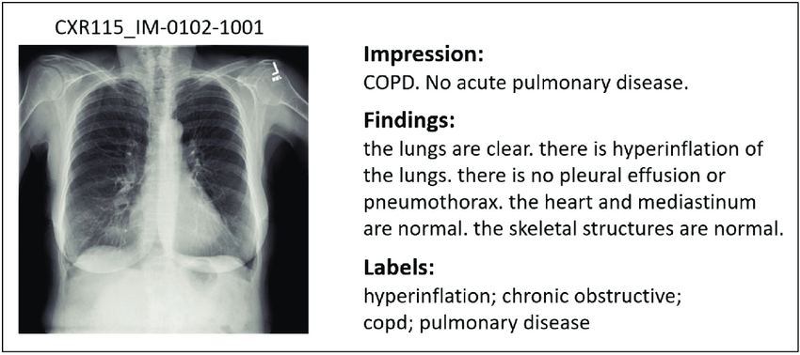
Example Report

Slide 6
Data
The study will leverage two primary datasets, MIMIC-CXR-JPG and IU Xray, both encompassing chest X-ray images paired with corresponding reports.
MIMIC-CXR: Utilize the free-text reports
Size: 227,827 free-text radiology reports.
Providing recommended train/validation/test data splits.
MIMIC-CXR-JPG v2.0.0: Generated from MIMIC-CXR. Utilized their JPG formatted image files.
Include different View Position: "AP", "PA", "LATERAL"
Size: Comprises 377,110 JPG format images.
Chest X-rays Indiana University (IU X-ray)
Size: 7,470 chest X-ray images with 3,955 radiology reports.
Train/Val/Test = 6:2:2 (by patient)
Notes:
(e.g. one frontal and one lateral image),

Slide 7
Materials and Methods
Materials:
Chexbert
Pretrained Image Encoder
Pretrained Alignment Model
Pretrained Large Language Model
Methods:
Training/Fine-Tuning
Alignment model - monitor training loss
LLM (vicuna) model - using LoRA
Prompt tuning:
Focus on Specific Findings
Chest X-ray Analysis
Focus on Radiology Style
Notes:
LoRA, or Low-Rank Adaptation, is a machine learning technique that fine-tunes large models without needing to fully train the model.

Slide 8
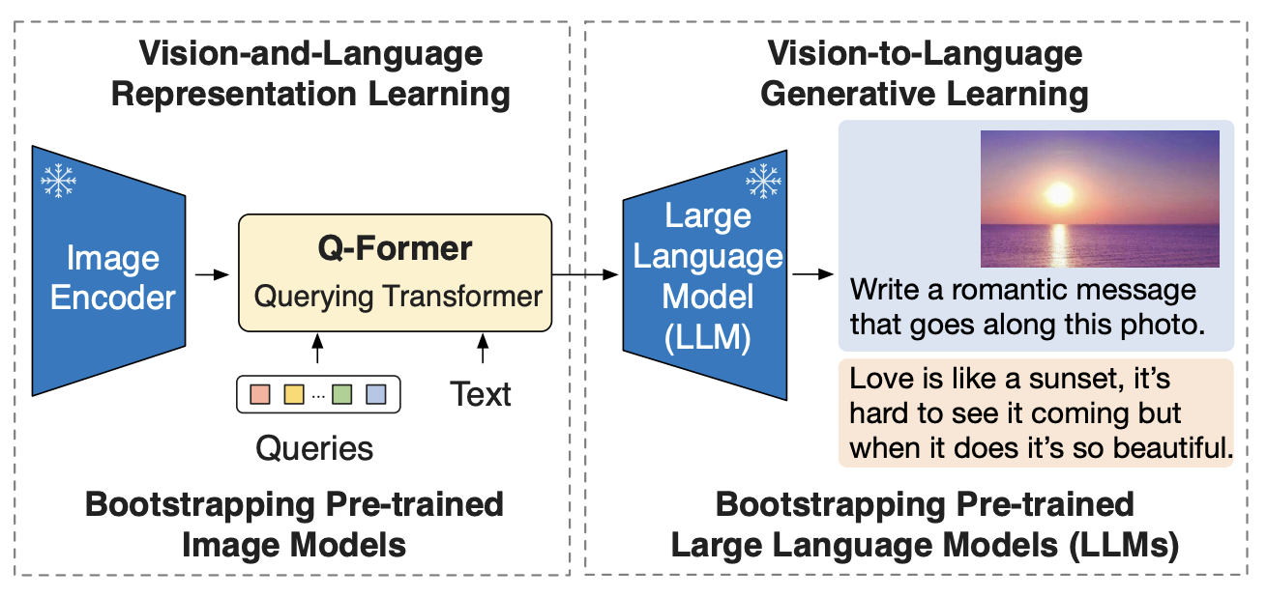
BLIP-2
(Bootstrapping Language-Image Pre-training with
Frozen Image Encoders and Large Language Models)

Slide 9
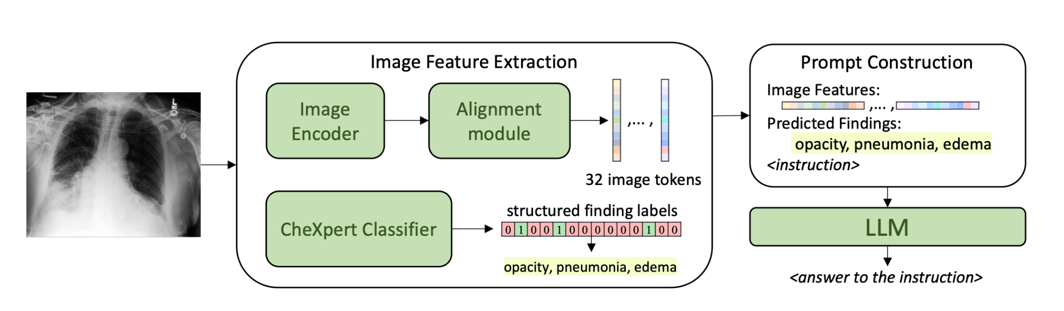
Materials and Methods
Model Architecture
BioVil-T
Qformer
PA, AP, LA
Vicuna (7b or 13b)
BioViL-T is a domain-specific vision-language model designed to analyze chest X-rays (CXRs) and radiology reports. Trained on MIMIC-CXR.
CheXpert Classifier: a multi-label classifier for chest X-ray image that outputs probabilities of 14 different observations (including 12 pathologies, "No Finding", and "Support Devices").

Slide 10
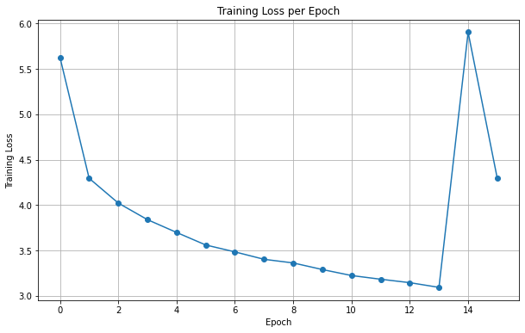
Materials and Methods
The loss during the training of the Alignment model

Slide 11
Materials and Methods
Original Prompt:
Prompt - Focus on Specific Findings
"Image information: <IMG><IMG><IMG><IMG><IMG><IMG><IMG><IMG><IMG><IMG><IMG><IMG><IMG><IMG><IMG><IMG><IMG><IMG><IMG><IMG><IMG><IMG><IMG><IMG><IMG><IMG><IMG><IMG><IMG><IMG><IMG><IMG>. Predicted Findings: {findings}. You are to act as a radiologist and write the finding section of a chest x-ray radiology report for this X-ray image and the given predicted findings. Write in the style of a radiologist, write one fluent text without enumeration, be concise and don't provide explanations or reasons."
"Image information: <IMG><IMG><IMG><IMG><IMG><IMG><IMG><IMG><IMG><IMG><IMG><IMG><IMG><IMG><IMG><IMG><IMG><IMG><IMG><IMG><IMG><IMG><IMG><IMG><IMG><IMG><IMG><IMG><IMG><IMG><IMG><IMG>. Predicted Findings: {findings}. Focus on these findings and write a concise chest X-ray report in the style of a radiologist. Emphasize the reported findings while keeping the report clear and informative."

Slide 12
Materials and Methods
Prompt - Chest X-ray Analysis
Prompt - Focus on Radiology Style
"Given the provided image <IMG><IMG><IMG><IMG><IMG><IMG><IMG><IMG><IMG><IMG><IMG><IMG><IMG><IMG><IMG><IMG><IMG><IMG><IMG><IMG><IMG><IMG><IMG><IMG><IMG><IMG><IMG><IMG><IMG><IMG><IMG><IMG> and predicted findings ({findings}), generate a concise chest X-ray report in the style of a radiologist. Prioritize these findings while maintaining clarity and conciseness."
"iven the image data (<IMG><IMG><IMG><IMG><IMG><IMG><IMG><IMG><IMG><IMG><IMG><IMG><IMG><IMG><IMG><IMG><IMG><IMG><IMG><IMG><IMG><IMG><IMG><IMG><IMG><IMG><IMG><IMG><IMG><IMG><IMG><IMG>) and predicted findings ({findings}), create a chest X-ray report that emulates the conciseness and clarity of a radiologist's report. Emphasize the identified findings while keeping the report informative."

Slide 13
Result
Natural Language Generation (NLG) metrics:
BLEU (Bilingual Evaluation Understudy): BLEU-1, BLEU-4 (B-4)
METEOR (Metric for Evaluation of Translation with Explicit ORdering)
ROUGE (Recall-Oriented Understudy for Gisting Evaluation)

Slide 14
Result
 | BLEU-1 | BLEU-2 | BLEU-3 | BLEU-4 | METEOR | ROUGE_L
MIMIC-CXR_pretrained | 0.340 | - | - | 0.097 | 0.136 | 0.270
IU_pretrained | 0.343 | 0.211 | 0.140 | 0.089 | 0.141 | 0.245
IU_retrained (allign) | 0.325 | 0.181 | 0.112 | 0.070 | 0.143 | 0.234
IU_retrained (allign+llm) | 0.317 | 0.174 | 0.107 | 0.068 | 0.133 | 0.242
IU_retrained (allign+llm)-1 | 0.233 | 0.123 | 0.068 | 0.038 | 0.157 | 0.212
IU_retrained (allign+llm)-2 | 0.288 | 0.158 | 0.090 | 0.055 | 0.150 | 0.238
IU_retrained (allign+llm)-3 | 0.321 | 0.183 | 0.112 | 0.068 | 0.147 | 0.226

Slide 15
Example Output
Ground true:
The cardiomediastinal silhouette is within normal limits for size and contour. The lungs are normally inflated without evidence of focal airspace disease, pleural effusion, or pneumothorax. No acute osseus abnormality.
Pred:
The lungs are clear without focal consolidation. No pleural effusion or pneumothorax is seen. The cardiac and mediastinal silhouettes are unremarkable.

Slide 16
Conclusion & Discussions
Conclusion:
Baseline model outperform the fine-tuned model on the IU chest X-ray dataset.
Discussions:
Possible reasons:
For Alignment model- Overfitting
For LLM - Vicuna use 7b instead of 13b.
For LLM - Insufficient Fine-Tuning (more epochs)
Future work:
Add more features in the prompt
Include Confidence Levels for ‘findings’
Adding clinical efficacy as another metric to evaluate model performance

Slide 17
Thank you for your time!

Slide 18
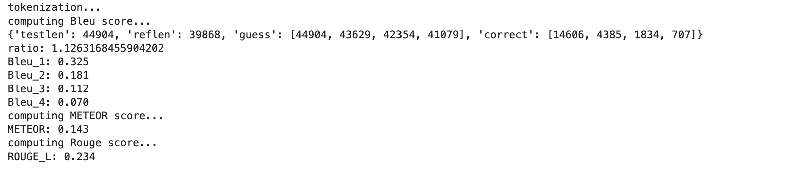
Results
Before Training
Prompt - img_matching_examples_ig2_noexamples_IMG_findings

Slide 19
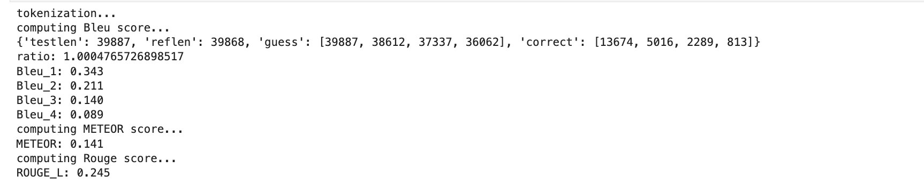
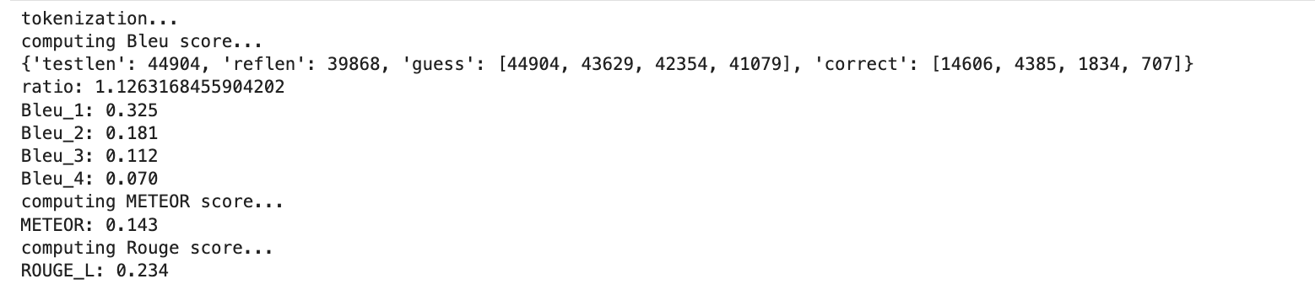
img_matching_examples_ig2_noexamples_IMG_findings
Add training loss
For alignment model training
The evaluation on ‘test’
Using the new trained alignment model

Slide 20
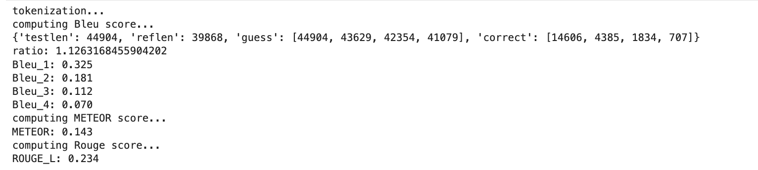
Add training loss
For alignment model training
The evaluation on ‘test’
Using the new trained alignment model + use_embs
prompt_type="img_matching_examples_ig2_noexamples_IMG_findings"
Notes:
Train alignment model, 沒什麼效果
>>

Slide 21
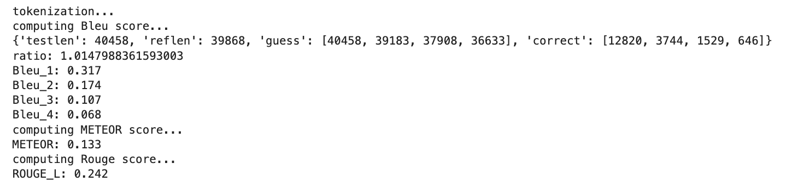
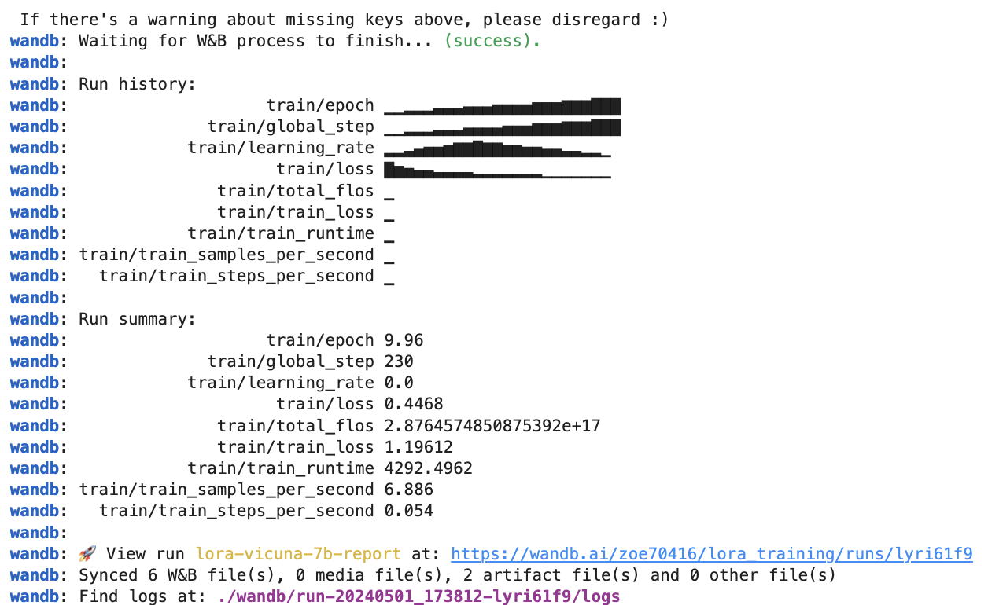
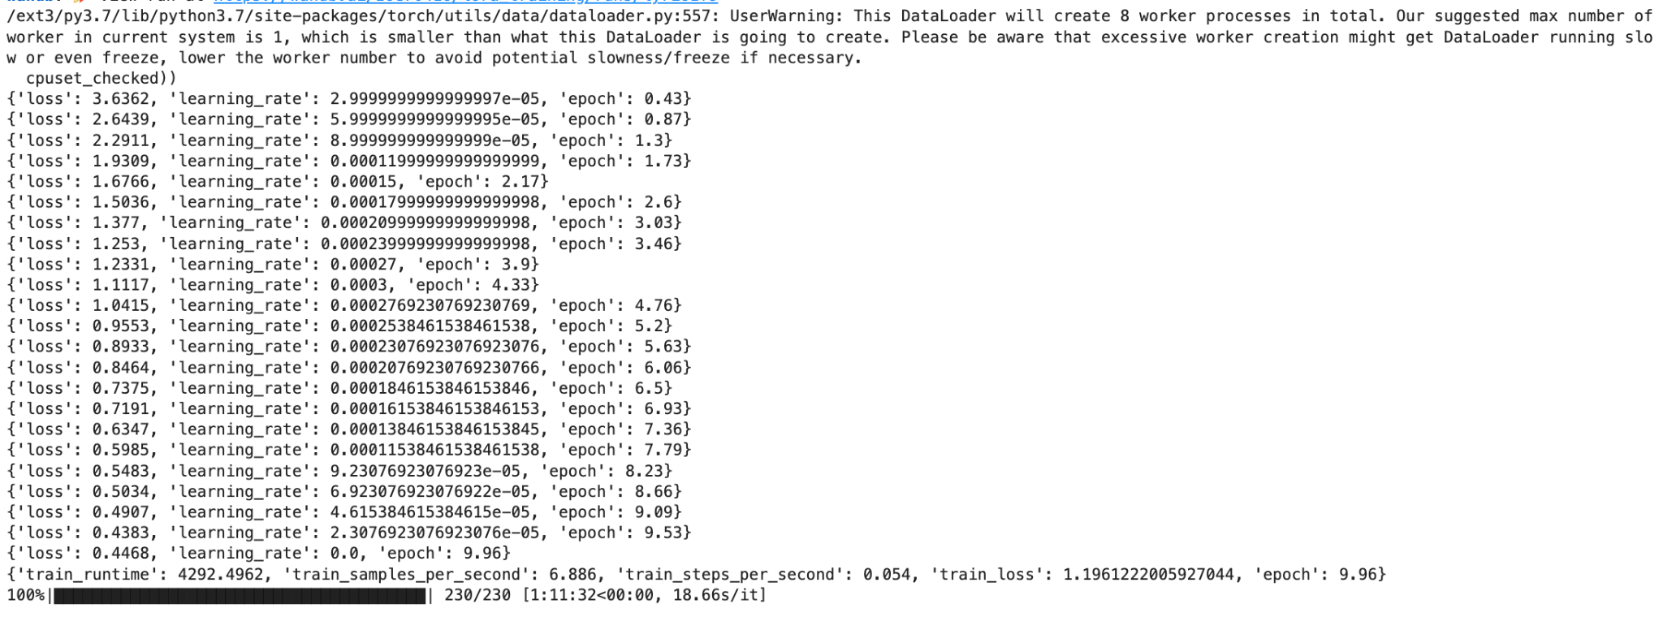
Add training loss
For LLM training
The evaluation on ‘test’
Using the new trained alignment model + new LLM model

Slide 22
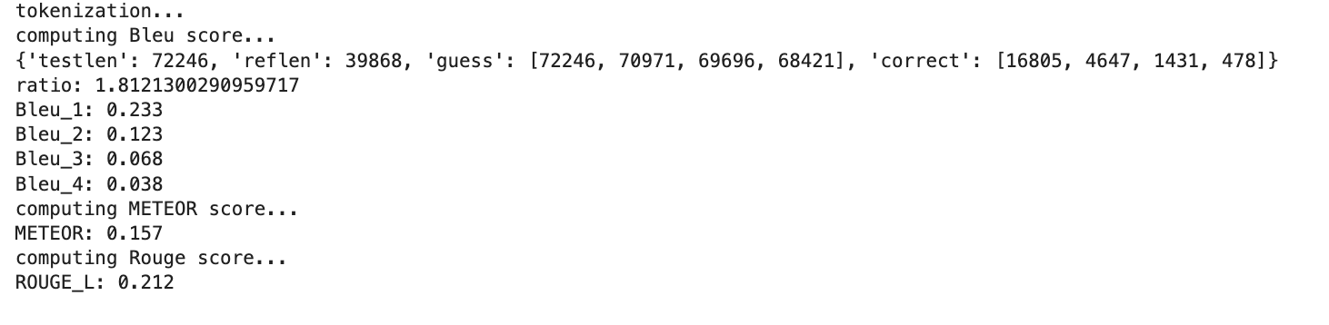
"img_matching_example_focus_on_specificfindings"
Notes:
With new llm but without emb

Slide 23
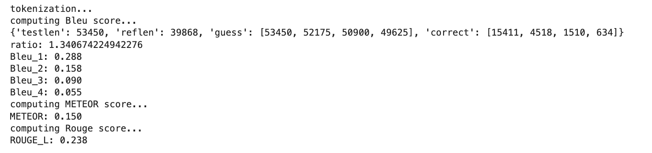
img_matching_example_chest_xray_analysis

Slide 24
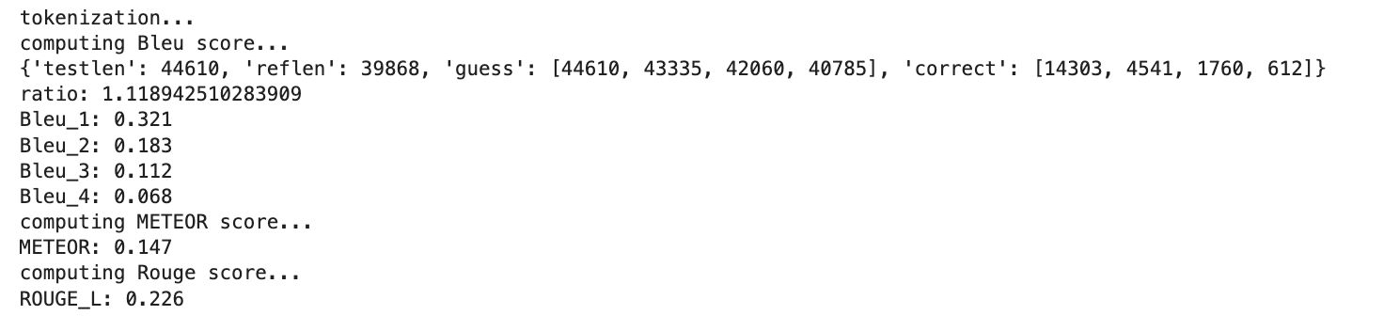
img_matching_example_focus_on_radiology_style

